Slide 1
Interior Business Architecture Team (IBAT)
Kick-Off Meeting
July 24, 2003
Sponsor: W. Hord Tipton, DOI CIO

Slide 2
IBAT AGENDA
What Are We Charged to Do?...........................................................Hord Tipton
Enterprise Architecture – Federal Direction……………………...Colleen Coggins
IEA End Outcomes……………………………………………….…Colleen Coggins
IEA Business Value……………………………………............……..James Barrett
OMB Federal Enterprise Architecture (FEA) Overview…………Colleen Coggins
Financial Management & Popkin Demo………………...……….Colleen & James
IBAT Roles & Meeting Logistics…………….…………...……….…IBAT Members
Open Discussion……………...………………………………………IBAT Members

Slide 3
WHAT ARE WE CHARGED TO DO?
Hord Tipton
DOI CIO

Slide 4
Extracts From OMB FY 2004 Budget Passback:
The DOI is directed to create an integrated and comprehensive departmental process for EA;
Reduce redundancies in these separate approaches;
Map to the Federal Enterprise Architecture efforts of OMB.
OMB endorsed the BLM EA process.
EA developed to a detail level that ensures the efficient management of Department IT resources,
Notes:
Before discussing what they want from us. Let’s examine how they’ve shown us their displeasure in our performance. Albeit most of this is targeted at the Departmental level, we’re suffering in the balance.
They’ve levied a substantial cut in IT. They’ve stated in meetings that the Department doesn’t do an adequate job of screening Major IT investments for duplication, mission essential, architecture alignment, etc.
They’ve scored many of the Bureau’s 300Bs Low. (Check which ones)
They don’t see an overarching connected game plan.
Let’s review the OMB Budget Pass Back Language

Slide 5
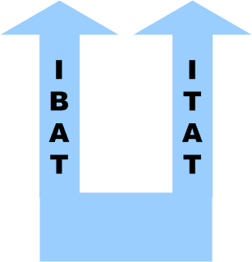
Interior Enterprise Architecture – A New Approach
Refocused the IEA to align with OMB Federal Enterprise Architecture (FEA) Reference Models
Performance, Business, Data, Service and Technology Reference Model
Created two teams to fast-track IEA development
Interior Business Architecture Team (IBAT)
Business layers of Architecture (e.g., Performance and Business Reference Models)
Interior Technical Architecture Team (ITAT)
Technology Layers of Architecture (e.g., Technology Reference Model, etc.)
Incorporating Existing Bureau (e.g., MMS, BLM) & Business Area (e.g., Recreation, Fire) artifacts into unified DOI Architecture
Establishing IEA governance
Ensure IT investments adhere to the IEA.

Slide 6
Interior Enterprise Architecture Program - Accomplishments
MAY 2003
DOI Briefed Version 1.0 of the Interior Business Architecture (IBA) concentrating on Financial Management Business Area to OMB
OMB Endorsed Methodology, Tools and Approach of IEA.
Briefing resulted in OMB release of DOI FBMS system out of “Architecture Jail”
June 2003
DOI Updating Technical Reference Model – Defines DOI approved technology and product standards.
DOI Names Popkin System Architect as DOI Architecture Repository Standard
DOI Launches Popkin IPT to launch DOI-Standard Architecture Repository
DOI Launches Data Resources Management Program
July 2003
DOI Lifts Bureau-level Architecture Freeze
DOI Announces Initial Business & Data Architecture Focus of 5 Business Areas
DOI Establishes IBAT
DOI Positioned to Pilot Popkin Across DOI WAN

Slide 7
Enterprise Architecture – Federal Direction
Colleen Coggins
Interior Business Architect

Slide 8
Achieving Results from IT: Last Year’s Analysis Identified Six Chronic Problems
Poor Modernization Blueprints: Few agencies had a business-driven enterprise architectures, a roadmap that showed what IT investments will be used to better improve performance
Paving Cowpaths: Agencies automated management problems, instead of leveraging e-business to fix them
Redundant Buying: Multiple agencies bought the same item, instead of driving economies of scale or creating one-stop points of service
Program Management: Few delivered on time, on budget
Islands of Automation:
Citizens have to deal with multiple agencies (22,000 websites) to get service, instead of going to a single point of service website or call center
Agencies cannot easily collaborate for key missions like Homeland Security.
Poor Cyber Security: IT security is seen as an IT or funding issue, instead of agency management issue
Source: Briefing from Mark Forman (OMB AD for IT & E-GOV); September 2002
Notes:
Program Performance Value :
IT bought for agency operations —not citizens' interface needs.
Systems evaluated wrongly (e.g., % time they are working, rather effect on the programs they support).
Technology Leverage:
Technology does not replace good management, but good government management requires technology
Government traditionally uses IT to automate existing processes, rather than to create more effective business practices.
Islands of Automation :
22,000 Websites: citizens have to deal with multiple agencies to get service,
5,600 GPEA Transactions: businesses have to fill-out multiple forms that ask for the same information, and
Agencies cannot easily collaborate for key missions like Homeland Security.
Resistance to Change : Budget processes and agency cultures perpetuate silos.
Budgeting processes support silos.
Agency cultures and fear of reorganization create resistance to integrating workload or sharing systems across several agencies.

Slide 9

WHAT DOES OMB WANT FROM US?
WHAT HAVE THEY TOLD FEDERAL AGENCIES?
OMB Has A Two-pronged Approach For Driving Progress: Each Cabinet-level Department and Agency is Rated Quarterly
Agency E-government Progress
Modernization Blueprint -- Enterprise Architecture
Business Cases -- Capital Planning and Investment Control
IT Program Management
IT Security
Multi-agency E-Government Initiative Involvement
Source: Mark A. Forman, Associate Director for IT and E-Government (OMB) Briefing: Enterprise Architectures That Matter
Notes:
EGov is the What or Destination EA is the How or Roadmap of how you get there (Mark Forman says this a lot)
As you can see the means for achieving E-Gov progress is directly related to an mature CIO Program that includes:
EA, CPIC, Successful IT Program Mgmt. & IT Security.
They’re telling us that an Agency’s EA & E-GOV Strategies must be integrated!!
A MODERNIZATION BLUEPRINT = A TARGET ARCHITECTURE

Slide 10
WHAT DOES OMB WANT FROM US?
WHAT HAVE THEY TOLD FEDERAL AGENCIES?
Fundamentals for Success in Applying Web Services
Identify common functions, interdependencies, interrelationships, and evaluate barriers to information sharing
Implement in a way that addresses both the opportunities and risks of a “networked” environment
Leverage technologies to achieve benefits of interoperability while protecting societal values of privacy and intellectual property rights, etc.
Source: Mark A. Forman, Associate Director for IT and E-Government (OMB)
Briefing: Enterprise Architectures That Matter
Notes:
The BEA’s Primary MISSION IS TO EFFECTIVELY PLAN IT INVESTMENTS THAT ARE LINKED TO BUSINESS PRIORITIES EFFICIENTLY.
THE BEA PROVIDES THE MEANS FOR ACHIEVING THE ABOVE THREE FUNDAMENTALS FOR ACHIEVING E-GOV. IT IS THE PRIMARY STOREHOUSE OF THE ABOVE INFORMATION.
BLM HAS BEEN HAMPERED IN THE PAST FROM DEVELOPING THIS PLAN – TARGET ARCHITECTURE BECAUSE WE LACKED THE TOOL TO EFFECTIVELY PERFORM THE FIRST BULLET AT AN ENTERPRISE LEVEL.
WE’VE COLLECTED THE DATA BUT HAD NO REAL MECHANISM FOR PERFORMING THE ANALYSIS AT AN ENTERPRISE LEVEL. NOW THAT WE’VE MIGRATED ALL THE INFORMATION TO A TOOL SET THAT ALLOWS US TO PERFORM THESE ANALYSES WE ARE WELL POSITIONED TO DEVELOP OUR EA BLUEPRINT – WITH YOUR HELP!

Slide 11
WHAT DOES OMB WANT FROM US?
WHAT HAVE THEY TOLD FEDERAL AGENCIES?
END-TO-END DIGITAL SERVICE DELIVERY IS THE NEW PARADIGM
Developing a modernization blueprint
Component-based enterprise architecture that addresses the business lines, data, information, and technology necessary to meet our missions.
CIO Council/OMB Analysis identifying internal/external interrelationships and interdependencies at each layer
Within and across departments
Privacy and security are key components of this architecture
Eliminate investments in redundant IT capabilities
Unify and Simplify: Shared investments and process integration to leverage common components in making government citizen centered and driving results
Common business functions
Vertical or horizontal integration needed to perform
Source: Mark A. Forman, Associate Director for IT and E-Government (OMB) Briefing: Enterprise Architectures That Matter
Notes:
The BEA’s Primary MISSION IS TO EFFECTIVELY PLAN IT INVESTMENTS THAT ARE LINKED TO BUSINESS PRIORITIES SECURELY AND EFFICIENTLY.
THE BEA PROVIDES THE MEANS FOR ACHIEVING THE ABOVE THREE FUNDAMENTALS FOR ACHIEVING E-GOV. IT IS THE PRIMARY STOREHOUSE OF THE ABOVE INFORMATION.
BLM HAS BEEN HAMPERED IN THE PAST FROM DEVELOPING THIS PLAN – TARGET ARCHITECTURE BECAUSE WE LACKED THE TOOL TO EFFECTIVELY PERFORM THE FIRST BULLET AT AN ENTERPRISE LEVEL.
WE’VE COLLECTED THE DATA BUT HAD NO REAL MECHANISM FOR PERFORMING THE ANALYSIS AT AN ENTERPRISE LEVEL. NOW THAT WE’VE MIGRATED ALL THE INFORMATION TO A TOOL SET THAT ALLOWS US TO PERFORM THESE ANALYSES WE ARE WELL POSITIONED TO DEVELOP OUR EA BLUEPRINT – WITH YOUR HELP!

Slide 12
IEA End Outcomes
Colleen Coggins
Interior Business Architect

Slide 13
Aligning IT Investments with Business Needs
IT Investments:
E-GOV Initiatives
Major System Development Efforts
Infrastructure Upgrades & Enhancements
BRM
DOI Business Priorities, Goals & Outcomes
Strategic Plan
Activity Based Costing (ABC),
Business Functions,
Data Requirements
Provides Basis
For Executive Decision Making,
& Project Coordination

Slide 14
Expected Outcomes:
Interior Business Architecture Team:
Define an Interior-wide modernization blueprint for IT investments that:
Supports Interior’s strategic priorities and business needs
Guides the decision making in the Capital Planning and Investment Control Process
Minimizes functional and data redundancies
Improves Overall Performance
Target Systems are based on Re-engineered/Optimized business processes
Target Systems adhere to the DOI Technical Reference Model

Slide 15
IBAT Business Value
Jim Barrett
Northrop Grumman – IBAT Support

Slide 16
Business Value of Interior Enterprise Architecture
How do the DOI Programs stand to benefit from this effort?
What does the IBA provide?

Slide 17
Interior Enterprise Architecture Provides
Enabling Capabilities
Analytical Tools and Information
Architecture Skills and Services
Recommendations:
How to manage and align IT investments with
Future business models (inter agency, e-gov)
Changing government landscape and directives (BRM)
Opportunities
Alignment with OMB can yield supporting program or infrastructure investment dollars

Slide 18
The Challenge Of Knowing Where The IT Dollar Goes?
How is our IT $ being spent?
What does it mean to my LOB?
Just what is going on?
Creates business oriented views
into how all of this works together
Get the Business Priority driving the
IT investments
IT Capital
Planning
IT Capital
Planning
Business
Priorities
Projects
Projects
PRM
BRM
Security
LOB
Security
CPIC
LOB
Priorities
IT Assets
CPIC
IT Assets
Architecture
Architecture

Slide 19
How is this Accomplished?
IEA follows the IT dollars:
Where has it been invested?
Where is it going to be spent?
Is it being spent effectively?
Does it align with the strategic planning and business objectives?

Slide 20
Strategy and Approach
Jim Barrett
Northrop Grumman – IBAT Support

Slide 21
Interior Business Architecture Approach
Team will use a combination of:
Top Down – Understanding the external and business drivers pushing the DOI
(e.g., President’s Management Agenda, Strategic Plan, ABC, and Competitive Sourcing)
Focusing on Interior-wide strategic business areas
Initial focus:
Financial Management
Recreation
Indian Trust
Law Enforcement
Wildland Fire Management
Bottom Up – Leveraging and Understanding business needs and architectures at the bureau/office level.
Bureau-level architecture efforts should focus on:
Business Areas Strategically important at bureau-level
Business Areas not targeted under IEA effort
Bureau-unique Business Functions
“BEST OF BREED WILL LEAD”

Slide 22
We Will Use Both ‘Top-down’ and ‘Bottom-up’ Methods As Part of Our Integrated Approach
Strategic Plan
Activity Based Costing Model
OMB Business Reference Model V2.0
Outcomes:
Modernization Blueprint
Near term $ savings on IT portfolios and business operations
Improved means for LOB prioritizations
Opportunities for organizational efficiencies
DOI Repository
Redundancies
Gaps/Voids for Target Models
Integration Opportunities
Technology Obsolescence
Gap Analysis
IT Expenditures, Business Cases
Bureaus Enterprise Architecture Artifacts

Slide 23
OMB FEA OVERVIEW
Colleen Coggins
Interior Business Architect

Slide 24
Interior Enterprise Architecture – FEA Alignment
Federal Enterprise Architecture (FEA)
IBA
Performance Reference Model (PRM)
Government-wide Performance Measures & Outcomes
Line of Business-Specific Performance Measures & Outcomes
Business Reference Model (BRM)
Lines of Business
Agencies, Customers, Partners
Business-Driven Approach
Service Component Reference Model (SRM)
Component-Based Architecture
Capabilities and Functionality
Services and Access Channels
ITA
Data Reference Model (DRM)
Business-focused data standardization
Cross-Agency Information exchanges
Technical Reference Model (TRM)
IT Services
Standards

Slide 25
The PRM’s six Measurement Areas are designed to capture the relationship between inputs, outputs, and outcomes.
Strategic Outcomes
Mission and
Customer
Mission and
Customer
Business
Results
Business
Results
OUTCOMES: Mission and business
-
Results
critical
Results
•
Customer
•
Customer
results aligned with Levels 1 and 3 of the
Satisfaction
•
Services for Citizens
Satisfaction
•
Services for Citizens
•
Service Coverage
•
Support Delivery of
•
Service Coverage
BRM. Results measured from a customer
•
Support Delivery of
•
Timeliness &
Services
•
Timeliness &
Services
Responsiveness
perspective.
•
Management of
Responsiveness
•
Management of
•
Service Quality
Government Resources
•
Service Quality
•
Government Resources
•
Service Accessibility
Financial
•
Service Accessibility
•
Financial
OUTPUTS: The direct effects of day
-
to
-
day
Processes and Activities
activities and broader processes measured
Processes and Activities
•
Financial
•
Quality
as driven by desired outcomes. Aligned
•
•
Financial
•
Management & Innovation
Productivity and Efficiency
•
•
Productivity and Efficiency
with Level 2 of the BRM.
Cycle and Resource Time
•
Cycle and Resource Time
Technology
Other Fixed
People
Technology
Other Fixed
INPUTS: Key enablers measured
People
Assets
•
•
Financial
Assets
•
Employee Satisfaction &
Financial
through their contribution to outputs
•
Employee Satisfaction &
Technology
–
•
Technology
•
Financial
Quality of Worklife
•
Quality & Efficiency
•
Financial
Quality of Worklife
•
Quality & Efficiency
•
Quality, Maintenance, &
and by extension outcomes
•
Recruitment & Retention
•
Information & Data
•
Quality, Maintenance, &
•
Recruitment & Retention
Information & Data
Efficiency
•
Employee Development
•
•
Reliability & Availability
Efficiency
•
Employee Development
•
Reliability & Availability
•
Security & Safety
•
Employee Ratios
•
User Satisfaction
•
Security & Safety
•
Employee Ratios
User Satisfaction
•
•
Utilization
Utilization
Value

Slide 26
Each PRM Measurement Category contains generic Indicators.
Measurement Area
Measurement Category
Strategic Outcomes
Performance Indicator
Mission and
Customer
Mission and
Customer
Business
Results
Business
Results
Productivity & Efficiency
Results
Results
•
Customer
•
Customer
Satisfaction
•
Services for Citizens
Satisfaction
•
Services for Citizens
•
Service Coverage
•
Support Delivery of
•
Service Coverage
Generic Performance Indicators
Total # of products produced, activities performed, or services provided per relevant unit of time
# of products produced, activities performed, or services provided per FTE
% of resources used versus resources available for use
# and/or % of products or services that are electronic
•
Support Delivery of
•
Timeliness &
Services
•
Timeliness &
Services
Responsiveness
•
Management of
Responsiveness
•
Management of
•
Service Quality
Government Resources
•
Service Quality
•
Government Resources
•
Service Accessibility
Financial
•
Service Accessibility
•
Financial
Processes and Activities
Processes and Activities
•
Financial
•
Quality
•
•
Financial
•
Management & Innovation
Productivity and Efficiency
•
•
Productivity and Efficiency
Cycle and Resource Time
•
Cycle and Resource Time
Technology
Other Fixed
People
Technology
Other Fixed
People
Assets
•
•
Financial
Assets
•
•
Employee Satisfaction &
Financial
Employee Satisfaction &
Technology
•
Technology
•
Financial
Quality of Worklife
•
Quality & Efficiency
•
Financial
Quality of Worklife
•
Quality & Efficiency
•
Quality, Maintenance, &
•
Recruitment & Retention
•
Information & Data
•
Quality, Maintenance, &
•
Recruitment & Retention
Information & Data
Efficiency
•
Employee Development
•
•
Reliability & Availability
Efficiency
•
Employee Development
•
Reliability & Availability
•
Security & Safety
•
Employee Ratios
•
User Satisfaction
•
Security & Safety
User Satisfaction
•
•
Utilization
Utilization
Value

Slide 27
Decision-makers then uniquely tailor or “operationalize” these Indicators to reflect their specific environment
Measurement Area
Measurement Category
Strategic Outcomes
Performance Indicator
Mission and Business Results
Customer Results
Mission and
Customer
Business
Results
Results
•
Customer
•
Customer
Satisfaction
•
Services for Citizens
Satisfaction
•
Services for Citizens
•
Service Coverage
•
Support Delivery of
•
Service Coverage
•
Support Delivery of
•
Timeliness &
Services
•
Timeliness &
Services
Responsiveness
•
Management of
Responsiveness
BRM Sub-function: Land Management
•
Management of
•
Service Quality
Government Resources
•
Service Quality
•
Government Resources
•
Service Accessibility
Productivity & Efficiency
Financial
•
Service Accessibility
•
Financial
Total # of products produced, activities performed, or services provided per relevant unit of time
# of products produced, activities performed, or services provided per FTE
% of resources used versus resources available for use
# and/or % of products or services that are electronic
Number of mine-scarred land acres improved for beneficial use
Processes and Activities
•
Financial
Processes and Activities
•
Financial
•
Quality
•
Productivity and Efficiency
•
Management & Innovation
•
•
Productivity and Efficiency
Cycle and Resource Time
•
Cycle and Resource Time
Technology
Other Fixed
People
Technology
Other Fixed Assets
People
•
•
Financial
Assets
•
Employee Satisfaction &
Financial
•
Employee Satisfaction &
Technology
•
Technology
•
Financial
Quality of Worklife
•
Quality & Efficiency
•
Financial
Quality of Worklife
•
Quality & Efficiency
•
Quality, Maintenance, &
•
Recruitment & Retention
•
Information & Data
•
Quality, Maintenance, &
•
Recruitment & Retention
Information & Data
Efficiency
•
Employee Development
•
•
Reliability & Availability
Efficiency
•
Employee Development
Reliability & Availability
•
Security & Safety
•
Employee Ratios
•
•
User Satisfaction
•
Security & Safety
User Satisfaction
•
•
Utilization
Utilization
Value
DOI Strategic Plan

Slide 28
The FEA Business Reference Model (BRM)
DOI supports over
50 BRM sub-functions
Telephone
Voice
Interactive
E-system
to System/
Web Services
Public/
Private
Partnerships
Internet/
Portal
Fax
Kiosk
Face to
Face
Mail
Services to Citizens
Services to Citizens
Program Admin
Compliance
Program Admin
Compliance
Public Asset Management
Public Asset Management
Regulated Activity Approval
Marketable Asset Management
Regulated Activity Approval
Marketable Asset Management
Consumer Safety
Defense & Nat’l Security Ops
Consumer Safety
Defense & Nat’l Security Ops
Environmental Management
On average 10 Cabinet Departments and agencies per Line of Business
Diplomacy & Foreign Relations
Environmental Management
Diplomacy & Foreign Relations
Law Enforcement
Disaster Management
Law Enforcement
Disaster Management
Legal
Domestic Economy
Legal
Domestic Economy
Revenue Collection
Education
Revenue Collection
Education
Trade (Import/Export)
Energy Management
Trade (Import/Export)
Energy Management
Transportation
Insurance
Transportation
Insurance
Workforce Management
Public Health
Workforce Management
Public Health
Recreation & National Resources
Recreation & National Resources
Social Services
Social Services
R&D & Science
R&D & Science
Web
Services
Telephone
Voice
Interactive
E-system
to System
Public/Private
Partnerships
Intranet/
Portal
Face to
Face
Fax
Mail
On average 21 Cabinet Departments and agencies per Line of Business
Support Delivery of Services
Legislative Management
Business Management of Information
IT Management, Regulator Management
Planning and Resource Allocation
Controls and Oversight
Public Affairs
Internal Risk Management and Mitigation
Federal Financial Assistance
All 24 Cabinet Departments and agencies per Line of Business
Inter-Agency
Internal Operations / Infrastructure
Intra-Agency
Human Resources, Financial Management Admin Supply Chain Management
Human Resources, Financial Management Admin Supply Chain Management
Notes:
The FEA Business Reference Model (BRM) is a function-driven framework for describing the Lines of Business performed by the Federal Government independent of the Agencies that perform them

Slide 29
The SRM framework is comprised of three (3) inter-related “service-orientated” tiers – each of which describes capabilities in greater levels of granularity
Service Layers
The collection of business oriented service categories that align service / component capabilities to a level in which they support the objectives and performance of the business.
7 Service Layers
Level of Granularity
Service Types
A collection of business-driven, service types (or categories) that assist the Service Layer in accomplishing of mission and/or performance objectives.
27 Service Types
Service Components
The collection of components and/or capabilities that support the Service Type.
143 Service Components

Slide 30
Customer Services
Extended descriptions of capabilities and functions are provided in Appendix B.
Defines the set of capabilities that are directly related to the end customer, the business’ interaction with the customer, and the customer driven activities or functions.
Customer Relationship Management (CRM)
Customer
Preferences
Customer Initiated
Assistance
Call Center Management
Customer Analytics
Sales and Marketing
Product / Brand Management
Customer / Account Management
Contact Management
Partner Relationship Mgmt
Customer Feedback
Surveys
Personalization
Subscriptions
Alerts and Notifications
Profile Management
Online Help
Online Tutorials
Self-Service
Reservations / Registration
Multi-Lingual Support
Assistance Request

Slide 31
DOI Conceptual Business Architecture Model

Slide 32
DOI Financial Management Architecture
Demonstration of Value
Demonstration of Approach

Slide 33
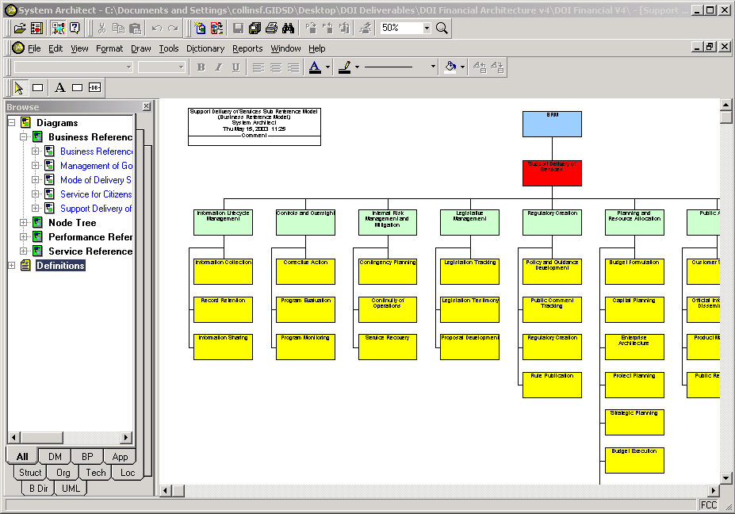
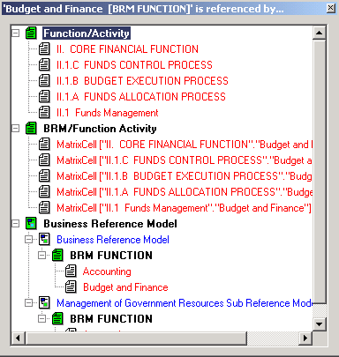
Integrated DOI BRM Report
DOI Financial Function / Activities mapped to OMB BRM V2
DOI Integrated BRM shows mappings between OMB BRM and DOI Financial Activities, DOI Financial Systems, and ABC elements
Use of a modeling tool allows rapid response to changes in the OMB’s BRM and clearly shows where multiple financial systems are mapped to a given function / activity
Linkages between PRM and BRM shows the relationship between functions performed and goals / objectives supported

Slide 34
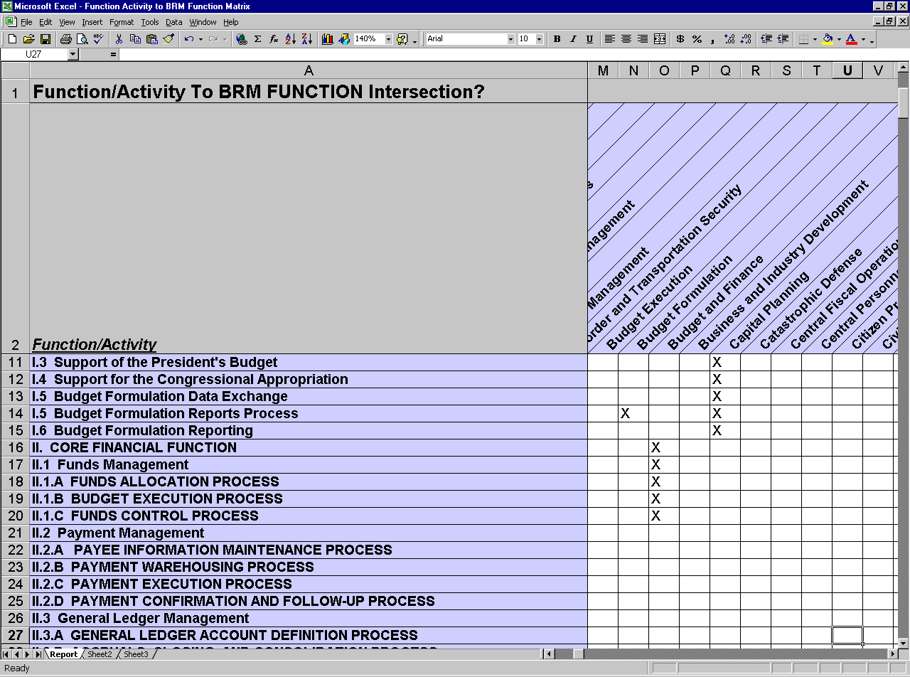
Function to BRM Matrix Report

Slide 35
Arming the Business Managers with Information to Drive Decision-Making
James Barrett
Northrop Grumman (IBAT Support)

Slide 36
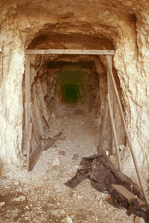

How can Line of Business (LOB) Manager “Mine” for Opportunities
How do my IT investments support my Strategic Outcomes?
What investments/adjustments must I make to assure accomplishment of my Strategic Outcomes?
Why does the LOB portfolio have so many applications?
How are they related?
Are there cost sharing opportunities?
What re-engineered processes can I leverage in my bureau?
How is my investment different than other LOBs?

Slide 37
“Plan of Attack”
Colleen Coggins
Interior Business Architect

Slide 38
Project Management Effort
Perform Project Planning and Event Scheduling
Create a DOI-wide As-Is/Baseline Applications Architecture mapped to the DOI BRM and PRM.
Create DOI Performance Reference Model (PRM)
Create DOI Business Reference Model (BRM)
Communications and Operations Support
Procure Popkin Licenses
Create critical path, resource loaded project plan
Maintain and update the project plan
Monthly Status Reports
Draft and Final Communications Plan
Bi-Monthly Printed Newsletters
Bi-Weekly Electronic Bulletins
DOI Business Architecture Intranet/Internet Websites
Draft and Final DOI PRM Meta-model defined within Popkin SA tool including Entity Relationship Diagram (ERD)
Draft and Final DOI PRM including Mapping of DOI Strategic Plan
Macros, scripts, and tailoring of Popkin SA to enable PRM HTML and Word/Excel report generation from Popkin SA tool
Create and define a DOI BRM consistent with FEA BRM and map the DOI BRM to the DOI PRM
Create the DOI BRM in the Popkin SA tool
Define and validate DOI BRM functions, activities, and principle tasks with DOI and Bureau-level stakeholders
Macros, scripts, and tailoring of Popkin SA to enable PRM HTML and Word/Excel report generation from Popkin SA tool
Draft and Final DOI Baseline Applications Architecture Meta-model in Popkin SA
Baseline application system shall be mapped to the DOI BRM & PRM
Macros, scripts, and tailoring of Popkin SA to enable Baseline Applications Architecture HTML and Word report generation from Popkin SA tool
5/1/03 – 5/30/03
5/15/03 – 6/31/03
7/1/03 – 8/31/03
6/01/03 – 10/31/03
Design for Implementing DOI-wide Popkin System Architecture Solution and accompanying form 300 in XML format.
Develop Plan to create and fully populate all FEA-models (i.e., PRM, BRM, SRM, DRM and TRM) for the DOI and its sub-Bureaus.
Develop complete “As-Is” Business Architecture for the following business areas:
Fire Management
Law Enforcement
Indian Trust
Financial Management
Recreation
Conduct Popkin SA Training
Fully maintain, update, administer and operate the D.E.A.R.
Draft and Final DOI-wide Popkin SA systems architecture design
Draft and Final Concept of Operations DEAR plan that includes SOP for:
Security Management and Access Control
Systems Administration
Configuration Management
Report enumerating existing enterprise architecture artifacts in existence across Bureaus
Documentation of Bureau - specific PRM, BRM, TRM, SRM, and DRM Metamodels
Plan, schedule, cost estimates by bureau and Departmental office for developing and fully populating all FEA models, bureau and DOI office reports, queries, etc
One-week customized Popkin training for up to 15 students
Accompanying training and reference material
Operational reports as required or directed by the TM (e.g., usage, access control lists, etc.)
Updated, secure and operational D.E.A.R
Draft and final business architecture for each of the five business areas and its relation to the overall DOI business architecture in hard copy report format and electronic version of populated Popkin S.A. encyclopedia.
5/15/03 – 7/31/03
8/1/03 – 10/31/03
7/1/03 – 10/31/03
9/1/03 – 10/31/03
5/1/03 – 10/31/03

Slide 39
IBAT Recommended Roles & Responsibilities
Colleen Coggins
Interior Business Architect

Slide 40
Recommended IBAT Roles and Responsibilities
Assure the IEA is business driven and supports the strategic priorities of DOI.
Recommend to the ITMC and MIT business improvements and technology investments that benefit the DOI overall.
Support, where feasible, cross-cutting solutions that are customer-centric.
Serve as the focal point of contact for respective bureau/office/business area on business architecture issues.
Actively participate in the development and validation of the business layers of the IEA.
Provide input on “best practice” solutions that may be leveraged across the DOI
Provide feedback into the overall IEA to continually improve the overall Program.

Slide 41
Immediate IBAT Participation Requested
5 Focal Business Areas –
Follow-up Interviews to determine functions, processes, and information requirements.
Office of Planning and Performance Management –
Assistance in mapping DOI Strategic Plan to OMB PRM for IBAT Review
Office of Budget
Assistance in mapping ABC work activities to DOI BRM Functions
Bureaus and Offices
Follow-up Interviews to determine existing architecture artifacts available for mapping into unified IEA.
Understanding of Business Areas for Focus in FY04 & 05.
Validation of existing and planned Major Applications to IEA models

Slide 42
IBAT Logistics
Open Discussion

Slide 43
IBAT Logistics
Establish Meeting Schedules
Frequency
Telcon logistics
Locations
IBAT Charter
Draft by next meeting

Slide 44
Questions, Concerns, Discussion
IBAT Members

